Slide 1
Sensors
Advanced Android Development
Lesson 3

Slide 2

3.2 Motion and position sensors
Monitor device movement or position in space

Slide 3
Contents
Overview of motion and position sensors
Determining device orientation
Understanding device rotation
Using motion sensors
Using position sensors

Slide 4
Overview
Motion and position sensors

Slide 5
Motion and position sensors
Motion and position sensors monitor device movement or position in space respectively
Both return multi-dimensional arrays of sensor values for each SensorEvent
Example: Accelerometer returns acceleration force data for 3 coordinate axes (x, y, z) relative to device

Slide 6
Coordinate systems
Device coordinate system : Some sensors use device coordinate system relative to the device
Example: Accelerometers
Earth coordinate system : Other sensors use Earth coordinate system relative to Earth surface
Example: Magnetometer

Slide 7
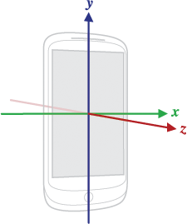
Device coordinates (1)
Relative to physical device regardless of device position in the world
x is horizontal and points right
y is vertical and points up
z points toward outside of screen
Negative z points behind screen

Slide 8
Device coordinates (2)
Relative to the device screen when device is in its default orientation
Axes are not swapped when orientation changes by rotation
App must transform incoming sensor data to match rotation

Slide 9
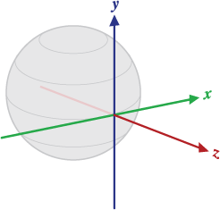
Earth coordinates
y points to magnetic north along Earth's surface
x is 90 degrees from y, pointing east
z extends up into space
Negative z extends down into ground

Slide 10
Determining device orientation

Slide 11
Device orientation
Position of device relative to Earth's coordinates (y points to magnetic north)
Determine by using accelerometer and geomagnetic field sensor with methods in SensorManager

Slide 12
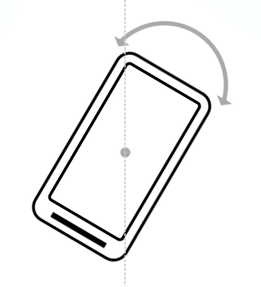
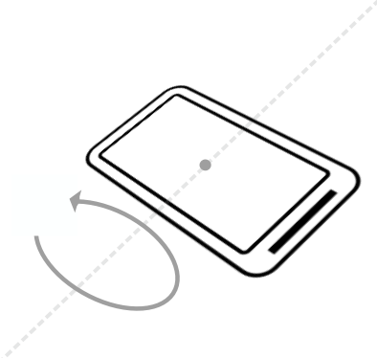
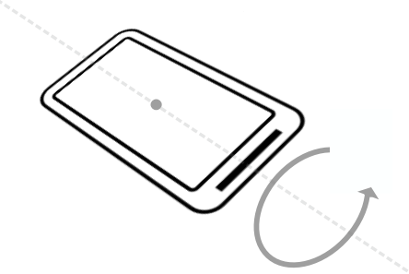
Components of orientation
Azimuth
Angle between device's compass direction and magnetic north
Pitch
Angle between plane parallel to device's screen and plane parallel to ground
Roll
Angle between plane perpendicular to device's screen and plane perpendicular to ground

Slide 13
SensorManager methods
getRotationMatrix() generates rotation matrix from accelerometer and geomagnetic field sensor
Translates sensor data from device coordinates to Earth coordinates
getOrientation() uses rotation matrix to compute angles of device's orientation

Slide 14
Example: Determine orientation
private SensorManager mSensorManager;
...
// Rotation matrix based on current readings.
final float[] rotationMatrix = new float[9];
mSensorManager.getRotationMatrix(rotationMatrix, null,
accelerometerReading, magnetometerReading);
// Express updated rotation matrix as 3 orientation angles.
final float[] orientationAngles = new float[3];
mSensorManager.getOrientation(rotationMatrix,
orientationAngles);

Slide 15
Understanding device rotation

Slide 16
Transform coordinates for rotation
If app draws views based on sensor data:
Screen or activity coordinate system rotates with device
Sensor coordinate system doesn't rotate
Need to transform sensor coordinates to activity coordinates

Slide 17
Handle device and activity rotation
Query device orientation with getRotationMatrix()
Remap rotation matrix from sensor data to activity coordinates with remapCoordinateSystem()

Slide 18
Returned from getRotation()
Integer constants:
ROTATION_0: Default (portrait for phones)
ROTATION_90: Sideways (landscape for phones)
ROTATION_180: Upside-down (if device allows)
ROTATION_270: Sideways in the opposite direction
Many devices return ROTATION_90 or ROTATION_270 regardless of clockwise or counterclockwise rotation

Slide 19
Example: Handle device rotation (1)
Use getRotation() with remapCoordinateSystem():
float[] rotationMatrix = new float[9];
boolean rotationOK =
SensorManager.getRotationMatrix(rotationMatrix,
null, mAccelerometerData, mMagnetometerData);
// Remap matrix based on current device/activity rotation.
float[] rotationMatrixAdjusted = new float[9];

Slide 20
Example: Handle device rotation (2)
switch (mDisplay.getRotation()) {
case Surface.ROTATION_0:
rotationMatrixAdjusted = rotationMatrix.clone();
break;
case Surface.ROTATION_90:
SensorManager.remapCoordinateSystem(rotationMatrix,
SensorManager.AXIS_Y, SensorManager.AXIS_MINUS_X,
rotationMatrixAdjusted);
Break;
// Rotation_180, Rotation_270 ...

Slide 21
Example: Handle device rotation (3)
// Rotation_180, Rotation_270
case Surface.ROTATION_180:
SensorManager.remapCoordinateSystem(rotationMatrix,
SensorManager.AXIS_MINUS_X,
SensorManager.AXIS_MINUS_Y, rotationMatrixAdjusted);
break;
case Surface.ROTATION_270:
SensorManager.remapCoordinateSystem(rotationMatrix,
SensorManager.AXIS_MINUS_Y, SensorManager.AXIS_X,
rotationMatrixAdjusted);
break;
}

Slide 22
Using motion sensors
Monitor device motion such as tilt, shake, rotation, swing

Slide 23
Motion sensors
The movement is usually a reflection of :
Direct user input relative to device/app (steering car in game, etc.)
Device motion relative to Earth (device is with you while you are driving)
Motion sensors are used with other sensors to determine device position relative to Earth

Slide 24
Accelerometer
TYPE_ACCELEROMETER measures acceleration along 3 device axes (x, y, z) including gravity
Acceleration without gravity: use TYPE_LINEAR_ACCELERATION
Force of gravity without acceleration: use TYPE_GRAVITY
TYPE_GYROSCOPE measures rate of rotation (radians/second)
For calculations see SensorEvent values

Slide 25
Accelerometer event data
Event data | Description | Units
SensorEvent.values[0] | Acceleration force along x-axis, including gravity | m/s²
SensorEvent.values[1] | Acceleration force along y-axis, including gravity | m/s²
SensorEvent.values[2] | Acceleration force along z-axis, including gravity | m/s²

Slide 26
Accelerometer example
private SensorManager mSensorManager;
private Sensor mSensor;
// ...
mSensorManager = (SensorManager)
getSystemService(Context.SENSOR_SERVICE);
mSensor = mSensorManager
.getDefaultSensor(Sensor.TYPE_LINEAR_ACCELERATION);

Slide 27
Gravity and gyroscope sensors
Along 3 device axes (x, y, z):
TYPE_GRAVITY measures gravity without acceleration
TYPE_GYROSCOPE measures rate of rotation (radians/second)
For calculations see SensorEvent values

Slide 28
Gravity event data
Event data | Description | Units
SensorEvent.values[0] | Gravity along x-axis | m/s²
SensorEvent.values[1] | Gravity along y-axis | m/s²
SensorEvent.values[2] | gravity along z-axis | m/s²

Slide 29
Rotation-vector sensor
TYPE_ROTATION_VECTOR provides orientation with respect to Earth coordinated as unit quaternion
Software sensor that integrates data from accelerometer, magnetometer, and gyroscope (if available)
Efficient and accurate way to determine device orientation
For calculations see SensorEvent values

Slide 30
Step counter and step detector
TYPE_STEP_COUNTER measures user steps since last reboot
To preserve battery use JobScheduler to retrieve current value from step-counter at specific interval
TYPE_STEP_DETECTOR: hardware sensor that triggers event for each step
Example: See the BatchStepSensor sample app

Slide 31
Using position sensors
Determine device physical position on Earth

Slide 32
Geomagnetic (magnetometer)
TYPE_MAGNETIC_FIELD measures strength of magnetic fields around device on each of 3 axes (x, y, z), including Earth magnetic field
Units are in microtesla (uT)
Find device position with respect to external world (compass)

Slide 33
Orientation
TYPE_ORIENTATION deprecated in API 8
For accurate device orientation (choose one):
Use getRotationMatrix() and getOrientation(), or
Use rotation-vector sensor with TYPE_ROTATION_VECTOR

Slide 34
What's next?
Concept chapter: 3.2 Motion and position sensors
Practical: 3.2 Working with sensor-based orientation

Slide 35
END

